Slide 1

Project Based Learning Review – 2 On VEHICLE RENTAL MANAGEMENT SYSTEM
CSE-A1(Team No: 3)
241003099: MITHUN PRAKASH REDDY
2410030109: ASHFAQ SAYEED(L)
2410030018: SAMPATH MOHAN
2410030429: SAI SHASHANK

Slide 2
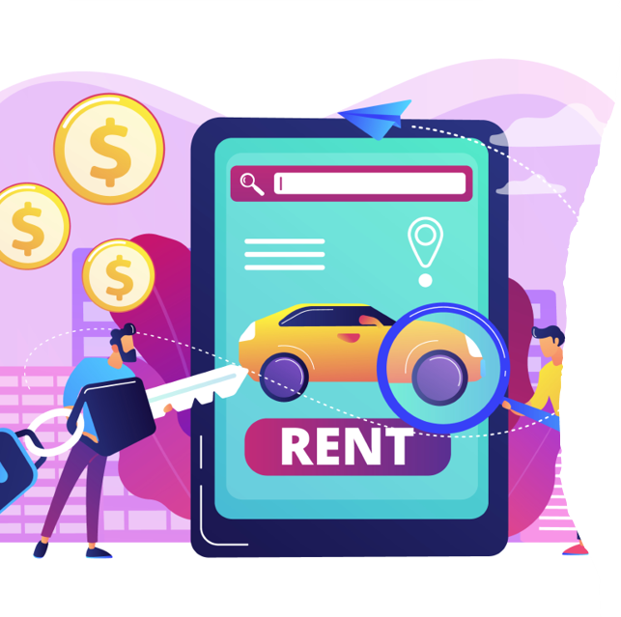
Introduction & Relevance to Project Title
The Problem: people often require vehicles with no driver to make their trip comfortable and also to get extra space.
Project Goal: To design and build a robust "Vehicle Rental Management System" that streamlines the entire rental lifecycle, from booking and tracking to flexible usage and convenient returns.
Relevance: Our project title is directly relevant as our system manages the complete rental process. It handles user data, vehicle inventory, and the logistics of booking, extension, and final vehicle pickup, all powered by a centralized database.

Slide 3
DEPTH ANALYSIS
Title | Key Findings | Source
Car Rental Management System – IJNRD (2024) | DBMS reduces redundancy, ensures data consistency, and improves booking efficiency. | Link
Development of Car Rental Management System with Scheduling Algorithm – ResearchGate (2022) | Scheduling algorithm improves vehicle allocation, reduces conflicts, and optimizes bookings. | Link
Vehicle Rental System – IRJMETS (2025) | Highlights importance of relational database for customer, vehicle, and payment management; reduces human errors. | Link
ONLINE CAR RENTAL SYSTEM – IJCSMC (2022) | Emphasizes real-time booking, CRUD operations for DB entities, and scalability for web-based applications. | Link

Slide 4

Depth & Quality of Literature Review
Commercial Platforms Studied (e.g., Zoomcar, Revv):
Strengths: Offer a wide variety of vehicles and have integrated online payment systems.
Weaknesses: Lack of transparent, real-time vehicle delivery status. The process to extend bookings is often trouble some. End-of-rental procedures can be inconvenient for the user.

Slide 5
Critical Analysis & Synthesis of Literature
Analysis: Current systems are heavily focused on the initial transaction (the booking) but neglect the user's experience during the crucial waiting and closing phases. Their database architecture is built for simple transactions but is not optimized for real-time updates or dynamic changes like booking extensions.
A dynamic, real-time data layer to manage the entire user journey transparently, from delivery to pickup.
A reliable transactional database for secure bookings.

Slide 6

Gap Analysis & Our Proposed Solution
Key Gaps Identified:
The Delivery Anxiety: Users have no live visual feedback on their vehicle's arrival.
Booking Inflexibility: Extending a rental period is difficult and not user-friendly.
The Return Hassle: Users bear the responsibility of returning the vehicle, which is often inconvenient.
Our Unique Solution: Our system is specifically designed to fill these gaps with three core features:
Live Progress Bar: For transparent, real-time delivery tracking.
One-Click Time Extension: Allows users to easily extend their booking duration via the app (subject to availability).
Assisted Worker Pickup: At the end of the rental, a worker is automatically dispatched to the vehicle's location for a hassle-free pickup.

Slide 7

Thank you

